Slide 1
SRM UNIVERSITY ANDHRA PRADESH
Introduction to Programming Using C Project Report On
Electronic Railway Ticket Booking (ERTB PROJECT)
Submitted In Partial Fulfillment For The Award Of The Degree In
BACHELOR OF TECHNOLOGY
IN
COMPUTER SCIENCE AND ENGINEERING
Submitted by
Group:12 Section:C
1.Krishna Sai Raj Ponneboina AP21110010165
2. Milan Liju Mathew AP21110010166
3. Gopi Chand Medisetty AP21110010167
Under the guidance of
Mrs.Vidya V

Slide 2
ABSTRACT
➭ As the name suggests Railway Reservation System is software that handles the entire booking data of the railway. It is fully based on the concept of reserving train tickets for various destinations. Previously the task of handling the tickets at a time was very difficult, so there was a need for software that can handle all Railway Reservation System.
➭ The Railway Reservation System facilitates the passengers to enquire about the trains available on the basis of source and destination, booking, cancellation, PNR Status, food services, etc.
➭ This project contains Introduction to the Railways Reservation System It is the computerized system of reserving the seats of train seats in advanced. It is mainly used for long route as well as for short route also. Online reservation has made the process for the reservation of seats very much easier than ever before.
➭ We have created separate logins for the passengers as well as admin, in which the admin login is password protected. The admin panel is password-protected so, the user other than admin will not be able to access the dashboard.

Slide 3
CONTENTS
Chapter No Chapter Name Page No
1 Introduction 4
2 Objective 5
3 System Requirement specifications 6
3.1 Hardware specifications
3.2 Software specifications
4 System Design 7-9
5 System Implementation 10-37
6 Results 38-45

Slide 4
CHAPTER 1
INTRODUCTION
➭ The whole project is based on a concept to reserve train tickets of various destinations with many other features like food services, accommodation, GPS, PNR status, WIFI, Etc.
➭ Technology has transformed many aspects of life in the 21st century. Now a days many of the people are preferring this online type activities (like online shopping, online transactions, online booking etc.). So, we think this project may be some how useful to all.
➭ Now coming to our project which is already mentioned above that the user can book the railway ticket through online. They are many advantages and features on ERTB (Electronic Railway Ticket Booking). In this the entire rights are given to the admin (like adding, modifying and cancellation and can know the information about all the trains they required.
➭ This project may use concept of file handling to store the booking data. Cancelling the ticket is a main feature of this project. And moreover, we may have displayed the menu of view information, book the ticket, cancel the ticket, admin, and exit. So, finally we are expecting that the project is more useful for society.

Slide 5
CHAPTER 2
OBJECTIVE
The objective of our project is to develop a system which will serve as a medium for peoples to book a ticket to travel through railways. The main goal is to ease the process of ticket booking by avoiding the hectic process to stand in a queue and book the ticket. This project intends to improve the railway administration system, which will be useful for both authorities and passengers.

Slide 6
CHAPTER 3
SYSTEM REQUIREMENTS
3.1 SOFTWARE REQUIREMENTS:
Language used: C
Operating System: Windows 7 Or Windows 10
3.2 HARDWARE REQUIREMENTS:
Hard Disk: 512 GB (Minimum)
Processor: Intel-i3 (Minimum)

Slide 7
CHAPTER 4
SYSTEM DESIGN
ALGORITHM :Algorithm is a step-by-step procedure, which defines a set of instructions to be executed in a certain order to get the desired output.
Step 1 → Start
Step 2 → print
1.Passenger
2. Admin
3. Exit
Step 4 → Read Choice
Step 5 → Switch case →Case 1 : Passenger
Case 2 : Admin
Case 3 : Exit
Default : print “YOU ENTERED WRONG CHOICE”

Slide 8
CHAPTER 4
SYSTEM DESIGN
ALGORITHM :
Step 6 → If Case 1: print
→ AVAILABLE TRAINS
→ MAKE RESERVATION
→ CANCEL RESERVATION
→ PNR STATUS
→ FOOD CATERING
→ MAIN MENU
Step 7 → If Case 2: print
→ VIEW PASSENGERS
→ ADD TRAIN
→ DELETE TRAIN
→ MAIN MENU
Step 8 → If Case 3: Exit
Step 9 → End

Slide 9
CHAPTER 4
SYSTEM DESIGN
BLOCK DIAGRAM:
Check out the available trains.
1.AVAILABLE
TRAINS
To make a reservation.
2.MAKE
RESERVATION
1.PASSENGER
For canceling a reservation.
3.CANCEL
RESERVATION
4.PNR
STATUS
Check the status of the PNR.
1.CHOOSE
PANEL
5.FOOD CATERING
For checking the food menu.
2.ADMIN
1.VIEW
PASSENGERS
To look at the tickets reserved for passengers.
2.ADD TRAIN
For adding a train.
3.DELETE TRAIN
To delete a train.

Slide 10
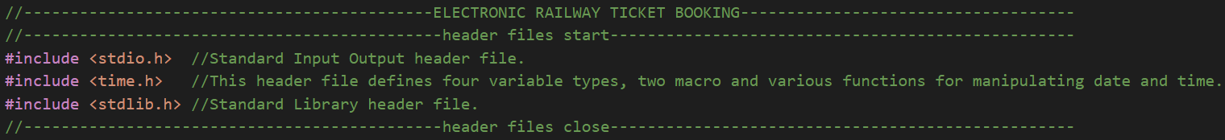
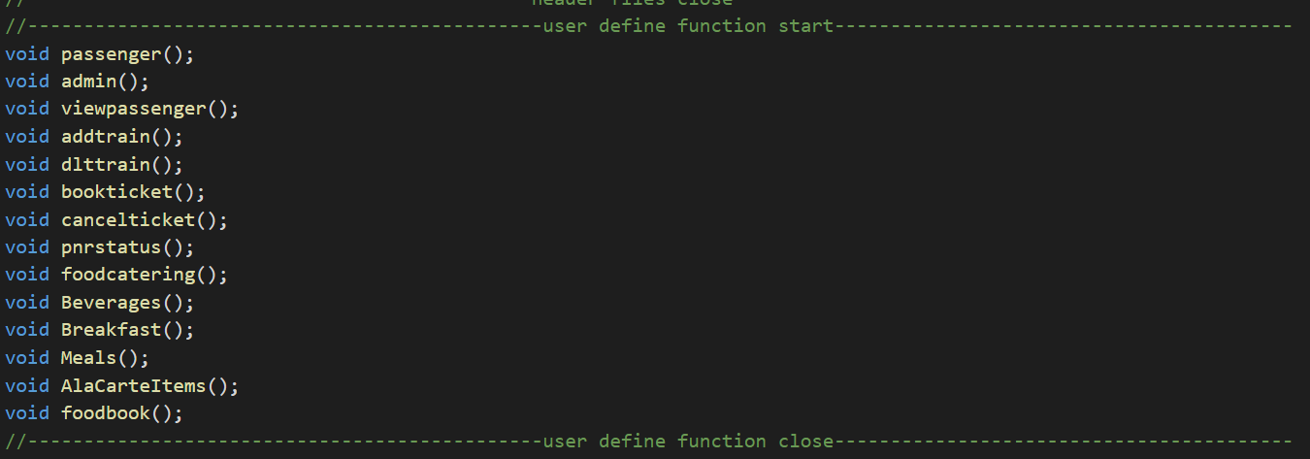
CHAPTER 5
SYSTEM IMPLEMENTATION
HEADER FILES:
Fig.5.1:Header Files
USER DEFINED FUNCTIONS:
Fig.5.2:User Defined Functions

Slide 11
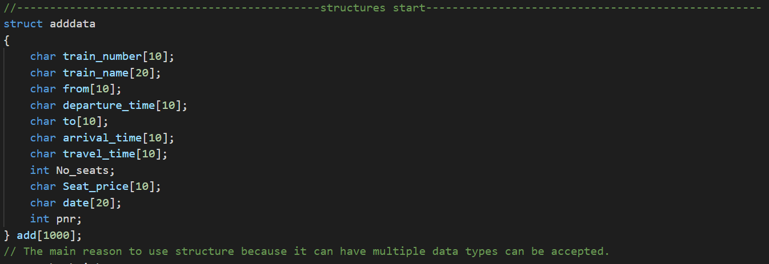
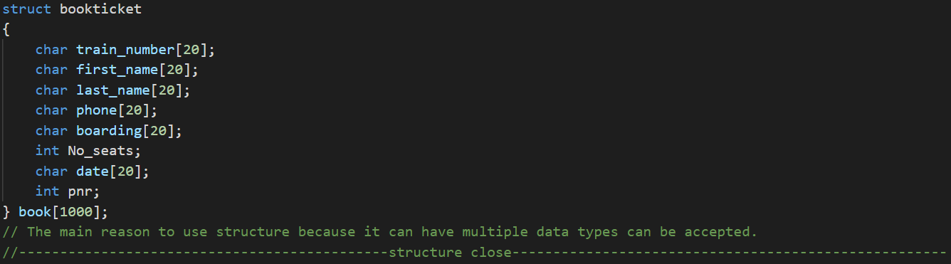
CHAPTER 5
SYSTEM IMPLEMENTATION
STRUCTURES:
Fig.5.3:Structures Fig.5.4:Structures
EXPLANATION: Here, the structures have been divided into two types like adddata and bookticket. Thus, the adddata contains all the details of the train which are added by the administrator such as the name of the train, the number of the train, etc. So, the bookticket contains all the details of the train that the passenger needs to enter to book the train ticket. Structure is a user-defined datatype in C Languagewhich allows us to combine data of different types together. Structure helps to construct a complex data type which is more meaningful. It is somewhat similar to an Array, but an array holds data of similar type only.

Slide 12
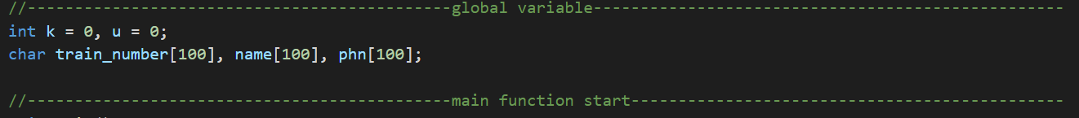
CHAPTER 5
SYSTEM IMPLEMENTATION
GLOBAL VARIABLES:
Fig.5.5:Global Variables

Slide 13
CHAPTER 5
SYSTEM IMPLEMENTATION
//---------------------------------------------main function start----------------------------------------------
void main()
{
aread();
viewpassengers_read();
printf("\n\n----------------------------------------------------------------------------------------------------------------------------------------------------------------------------");
printf("\n\n\t\t\t\t\t ********************Welcome To Electronic Railway Ticket Booking********************\n");
printf("\n\n----------------------------------------------------------------------------------------------------------------------------------------------------------------------------");
time_t t;
time(&t);
printf("\t\t\t\t\t\t\t\t\t\t\t\t\t\t\t\t\t\t%s", ctime(&t));
printf("----------------------------------------------------------------------------------------------------------------------------------------------------------------------------");
printf("\t\t\t\t\t\t\t\t\t\tPlease Choose Your Panel");
printf("\n\n\n\t\t\t\t[1] Passenger");
printf("\n\n\t\t\t\t[2] Admin");
printf("\n\n\t\t\t\t[3] Exit");
int i;
printf("\n\n\t\t\t\tEnter Your Choice: ");
scanf("%d", &i);
system("clear");
switch (i)
{
case 1:
system("clear");
passenger();
break;

Slide 14
CHAPTER 5
SYSTEM IMPLEMENTATION
case 2:
system("clear");
password();
break;
case 3:
system("clear");
exit(0);
break;
default:
system("clear");
printf("\n\n----------------------------------------------------------------------------------------------------------------------------------------------------------------------------");
printf("\n\n\t\t\t\t\t ********************Welcome To Electronic Railway Ticket Booking********************\n");
printf("\n\n----------------------------------------------------------------------------------------------------------------------------------------------------------------------------");
printf("\n\n\t\t\t\t\t\t\t\t!!!!!!!!YOU ENTERED WRONG CHOICE!!!!!!!!\n");
printf("\n\n\t\t\t\t\t\t\t\t!!!!!!!!PLEASE ENTER RIGHT THING!!!!!!!!\n");
getchar();
system("clear");
main();
}
getchar();
}
//---------------------------------------main function close-------------------------------------------------------
EXPLANATION: This is the main function where we can choose the passenger sign or admin sign or we can leave the program. The switch statement allows us to execute one code block among many alternatives. I therefore used switch statement among the alternatives.

Slide 15
CHAPTER 5
SYSTEM IMPLEMENTATION
//-------------------------------------admin portal function-------------------------------------------------------
void admin()
{
int chhh;
printf("\n\n----------------------------------------------------------------------------------------------------------------------------------------------------------------------------");
printf("\n\n\t\t\t\t\t\t\t********************Welcome To Admin Panel********************\n");
printf("\n\n----------------------------------------------------------------------------------------------------------------------------------------------------------------------------");
time_t t;
time(&t);
printf("\t\t\t\t\t\t\t\t\t\t\t\t\t\t\t\t\t\t%s", ctime(&t));
printf("----------------------------------------------------------------------------------------------------------------------------------------------------------------------------");
printf("\t\t\t\t\t\t\t\t\t\tCHOOSE YOUR OPERATION");
printf("\n\n\n\t\t\t\t\t\t\t[1] VIEW PASSENGERS");
printf("\n\n\t\t\t\t\t\t\t[2] ADD TRAIN");
printf("\n\n\t\t\t\t\t\t\t[3] DELETE TRAIN");
printf("\n\n\t\t\t\t\t\t\t[4] MAIN MENU");
printf("\n\n\n\t\t\t\t\t\t\tENTER YOUR CHOICE: ");
scanf("%d", &chhh);
switch (chhh)
{
case 1:
viewpassenger();
break;

Slide 16
CHAPTER 5
SYSTEM IMPLEMENTATION
case 2:
addtrain();
break;
case 3:
dlttrain();
break;
case 4:
system("clear");
main();
break;
default:
getchar();
printf("\n\t\t\tyou entered wrong key!!!!");
getchar();
system("clear");
admin();
}
getchar();
}
EXPLANATION: The administration portal will get the passenger list, add the train, delete the train options. We used the switch case because we have a lot of options so that the switch case may have a lot of alternative choices.

Slide 17
CHAPTER 5
SYSTEM IMPLEMENTATION
//-----------------------------------------------------------password function-----------------------------------------------------------------
void password()
{
int number = 12345;
int pass;
char user, id = user;
printf("\n\n----------------------------------------------------------------------------------------------------------------------------------------------------------------------------");
printf("\n\n\t\t\t\t\t ********************Welcome To Electronic Railway Ticket Booking********************\n");
printf("\n\n----------------------------------------------------------------------------------------------------------------------------------------------------------------------------");
time_t t;
time(&t);
printf("\t\t\t\t\t\t\t\t\t\t\t\t\t\t\t\t\t\t%s", ctime(&t));
printf("----------------------------------------------------------------------------------------------------------------------------------------------------------------------------");
printf("\n\n\n\t\t\t\t\t\t\t\t\tEnter password: ");
scanf("%d", &pass);
if (pass == number)
{
printf("\n\n\t\t\t\t\t\t\t\t You have logged in successfully");
getchar();
system("clear");
admin();
}
else
{

Slide 18
CHAPTER 5
SYSTEM IMPLEMENTATION
printf("\n\n\n\t\t\t\t\t\t\t\t Error! Entered password is wrong.");
getchar();
system("clear");
main();
}
}
EXPLANATION: We have secured the administration panel with password so that it may not be accessed by others.

Slide 19
CHAPTER 5
SYSTEM IMPLEMENTATION
//-------------------------------------------------------------------------passenger panel----------------------------------
void passenger()
{ {
int p;
printf("\n\n----------------------------------------------------------------------------------------------------------------------------------------------------------------------------");
printf("\n\n\t\t\t\t\t ********************Welcome To Passenger Ticket Booking Panel********************\n");
printf("\n\n----------------------------------------------------------------------------------------------------------------------------------------------------------------------------");
printf("\n\n\n\t\t\t[1] AVAILABLE TRAINS\n");
printf("\n\n\t\t\t[2] MAKE RESERVATION\n");
printf("\n\n\t\t\t[3] CANCEL RESERVATION\n");
printf("\n\n\t\t\t[4] PNR STATUS\n");
printf("\n\n\t\t\t[5] FOOD CATERING\n");
printf("\n\n\t\t\t[6] MAIN MENU\n");
printf("\n\n\t\t\t\tEnter Your Choice:");
scanf("%d", &p);
system("clear");
if (p == 1)
{ int ch, i;
system("clear");
aread();
printf("\n\n----------------------------------------------------------------------------------------------------------------------------------------------------------------------------");
printf("\n\n\t\t\t\t\t ********************Welcome To Electronic Railway Ticket Booking********************\n");
printf("\n\n----------------------------------------------------------------------------------------------------------------------------------------------------------------------------");

Slide 20
CHAPTER 5
SYSTEM IMPLEMENTATION
time_t t;
time(&t);
printf("\t\t\t\t\t\t\t\t\t\t\t\t\t\t\t\t\t\t%s", ctime(&t));
printf("----------------------------------------------------------------------------------------------------------------------------------------------------------------------------");
printf("\n\n\n \tTRAIN NO\tTRAIN NAME\tFROM\t DEPARTURE TIME\t TO\tARRIVAL TIME\tTOTAL TIME\tSL\tDATE\n\n");
for (i = 0; i < k; i++)
{
printf("\t %s\t\t %s\t\t%s\t %s\t\t %s\t %s\t%s\t%d\t%s\n", add[i].train_number, add[i].train_name, add[i].from, add[i].departure_time, add[i].to, add[i].arrival_time, add[i].travel_time, add[i].No_seats, add[i].date);
}
printf("\n\n\n\t\tEnter 1 to go back to previous menu or Enter 0 to go back to main menu");
printf("\n\n\n\t\tENTER YOUR CHOICE: ");
int v;
scanf("%d", &v);
system("clear");
switch (v)
{
case 1:
passenger();
break;
case 0:
system("clear");
main();
break;

Slide 21
CHAPTER 5
SYSTEM IMPLEMENTATION
default:
getchar();
printf("\n\t\t\tyou entered wrong key!!!!");
getchar();
system("clear");
main();
}
}
if (p == 2)
{
printf("\n\n----------------------------------------------------------------------------------------------------------------------------------------------------------------------------");
printf("\n\n\t\t\t\t\t ********************Welcome To Electronic Railway Ticket Booking********************\n");
printf("\n\n----------------------------------------------------------------------------------------------------------------------------------------------------------------------------");
time_t t;
time(&t);
printf("\t\t\t\t\t\t\t\t\t\t\t\t\t\t\t\t\t\t%s", ctime(&t));
printf("----------------------------------------------------------------------------------------------------------------------------------------------------------------------------");
printf("\n\n\n\n\n\n\n\t\tEnter '1' to proceed");
printf("\n\n\n\t\tEnter '2' to go back to previous menu or Enter '0' to go back to main menu");
printf("\n\n\n\t\tENTER YOUR CHOICE: ");
int v;
scanf("%d", &v);
system("cls");

Slide 22
CHAPTER 5
SYSTEM IMPLEMENTATION
switch (v)
{
case 1:
bookticket();
break;
case 2:
passenger();
break;
case 0:
system("cls");
main();
break;
default:
printf("\n\t\t\tyou entered wrong key!!!!");
getch();
system("cls");
main();
}
}
if (p == 3)
{
printf("\n\n----------------------------------------------------------------------------------------------------------------------------------------------------------------------------");
printf("\n\n\t\t\t\t\t ********************Welcome To Electronic Railway Ticket Booking********************\n");
printf("\n\n----------------------------------------------------------------------------------------------------------------------------------------------------------------------------");

Slide 23
CHAPTER 5
SYSTEM IMPLEMENTATION
time_t t;
time(&t);
printf("\t\t\t\t\t\t\t\t\t\t\t\t\t\t\t\t\t\t%s", ctime(&t));
printf("----------------------------------------------------------------------------------------------------------------------------------------------------------------------------");
printf("\n\n\n\n\n\n\n\t\tEnter '1' to proceed");
printf("\n\n\n\t\tEnter 2 to go back to previous menu or Enter 0 to go back to main menu");
printf("\n\n\n\t\tENTER YOUR CHOICE: ");
int v;
scanf("%d", &v);
system("clear");
switch (v)
{
case 1:
cancelticket();
break;
case 2:
passenger();
break;
case 0:
system("clear");
main();
break;
default:

Slide 24
CHAPTER 5
SYSTEM IMPLEMENTATION
printf("\n\t\t\tyou entered wrong key!!!!");
getchar();
system("clear");
main();
}
}
if (p == 4)
{
printf("\n\n----------------------------------------------------------------------------------------------------------------------------------------------------------------------------");
printf("\n\n\t\t\t\t\t ********************Welcome To Electronic Railway Ticket Booking********************\n");
printf("\n\n----------------------------------------------------------------------------------------------------------------------------------------------------------------------------");
time_t t;
time(&t);
printf("\t\t\t\t\t\t\t\t\t\t\t\t\t\t\t\t\t\t%s", ctime(&t));
printf("----------------------------------------------------------------------------------------------------------------------------------------------------------------------------");
printf("\n\n\n\n\n\n\n\t\tEnter '1' to proceed");
printf("\n\n\n\t\tEnter 2 to go back to previous menu or Enter 0 to go back to main menu");
printf("\n\n\n\t\tENTER YOUR CHOICE: ");
int v;
scanf("%d", &v);
system("clear");
switch (v)

Slide 25
CHAPTER 5
SYSTEM IMPLEMENTATION
printf("\n\t\t\tyou entered wrong key!!!!");
{
case 1:
status();
break;
case 2:
passenger();
break;
case 0:
system("clear");
main();
break;
default:
printf("\n\t\t\tyou entered wrong key!!!!");
getchar();
system("clear");
main();
}
}
if (p == 5)
{
printf("\n\n----------------------------------------------------------------------------------------------------------------------------------------------------------------------------");
printf("\n\n\t\t\t\t\t ********************Welcome To Electronic Railway Ticket Booking********************\n");
printf("\n\n----------------------------------------------------------------------------------------------------------------------------------------------------------------------------");

Slide 26
CHAPTER 5
SYSTEM IMPLEMENTATION
time_t t;
time(&t);
printf("\t\t\t\t\t\t\t\t\t\t\t\t\t\t\t\t\t\t%s", ctime(&t));
printf("----------------------------------------------------------------------------------------------------------------------------------------------------------------------------");
printf("\n\n\n\n\n\n\n\t\tEnter '1' to proceed");
printf("\n\n\n\t\tEnter 2 to go back to previous menu or Enter 0 to go back to main menu");
printf("\n\n\n\t\tENTER YOUR CHOICE: ");
int v;
scanf("%d", &v);
system("clear");
switch (v)
{
case 1:
foodcatering();
break;
case 2:
passenger();
break;
case 0:
system("clear");
main();
break;
default:

Slide 27
CHAPTER 5
SYSTEM IMPLEMENTATION
printf("\n\t\t\tyou entered wrong key!!!!");
getchar();
system("clear");
main();
}
}
if (p == 6)
{
system("clear");
main();
}
}
}
EXPLANATION: The passenger panel contains options like trains available, reservation, cancellation, PNR status, food menu.

Slide 28
CHAPTER 5
SYSTEM IMPLEMENTATION
//------------------------------------------book ticket-------------------------------------------------------------------------------------
void bookticket()
{
int c, j, n, i, found = -1;
char v, train_number[10];
system("cls");
aread();
printf("\n\n----------------------------------------------------------------------------------------------------------------------------------------------------------------------------");
printf("\n\n\t\t\t\t\t ********************Welcome To Electronic Railway Ticket Booking********************\n");
printf("\n\n----------------------------------------------------------------------------------------------------------------------------------------------------------------------------");
time_t t;
time(&t);
printf("\t\t\t\t\t\t\t\t\t\t\t\t\t\t\t\t\t\t%s", ctime(&t));
printf("----------------------------------------------------------------------------------------------------------------------------------------------------------------------------");
printf("\n\n\t\t\thow many ticket do you want to buy: ");
scanf("%d", &n);
for (j = u; j < u + n; j++)
{
printf("\n\n\t\t\tEnter train number: ");
scanf("%s", book[j].train_number);
for (i = 0; i < k; i++)
{
if (strcmp(book[j].train_number, add[i].train_number) == 0)

Slide 29
CHAPTER 5
SYSTEM IMPLEMENTATION
{
if (add[i].No_seats == 0)
{
printf("\n\n\t\t\tnot available seat");
getch();
system("cls");
main();
}
else
{
found = 1;
printf("\n\t\t\tenter book %d no ticket: ", j + 1);
printf("\n\t\t\tenter date: ");
scanf("%s", book[j].date);
printf("\n\t\t\tenter your name: ");
scanf("%s", book[j].first_name);
printf("\n\t\t\tenter your phone number: ");
scanf("%s", book[j].phone);
printf("\n\t\t\tseat number : %d", add[i].No_seats);
book[j].No_seats = add[i].No_seats;
printf("\n\n\n\t\tPNR:%d", add[i].pnr);
book[j].pnr = add[i].pnr;
bookticket_write();

Slide 30
CHAPTER 5
SYSTEM IMPLEMENTATION
add[i].No_seats--;
add[i].pnr++;
awrite();
}
}
}
if (found == -1)
{
printf("\n\n\t\t\ttrain not found!!!");
getch();
system("cls");
main();
}
}
u = j;
bookticket_write();
printf("\n\n\t\t\tenter '2' for main menu 1 for previous menu& press any key to exit: ");
scanf("%d", &c);
if (c == 1)
{
system("cls");
passenger();
}

Slide 31
CHAPTER 5
SYSTEM IMPLEMENTATION
if (c == 2)
{
system("cls");
admin();
}
else
{
exit;
}
}
EXPLANATION: This option enables us to book tickets where passenger details must be entered here i.e. name, phone number, date, etc.

Slide 32
CHAPTER 5
SYSTEM IMPLEMENTATION
//--------------------------------------view passengers function----------------------------------------
void viewpassenger()
{
int a, j;
system("clear");
printf("\n\n----------------------------------------------------------------------------------------------------------------------------------------------------------------------------");
printf("\n\n\t\t\t\t\t ********************Welcome To Electronic Railway Ticket Booking********************\n");
printf("\n\n----------------------------------------------------------------------------------------------------------------------------------------------------------------------------");
time_t t;
time(&t);
printf("\t\t\t\t\t\t\t\t\t\t\t\t\t\t\t\t\t\t%s", ctime(&t));
printf("----------------------------------------------------------------------------------------------------------------------------------------------------------------------------");
printf("\n\n\t\t\tTrain NO\t\tFIRST NAME\t\tPHONE\t\tDATE\t\tSEAT\t\tPNR\n");
for (j = 0; j < u; j++)
{
printf("\n\t\t\t%s\t\t\t%s\t\t%s\t\t%s\t%d\t\t%d", book[j].train_number, book[j].first_name, book[j].phone, book[j].date, book[j].No_seats, book[j].pnr);
book[j].No_seats++, book[j].pnr;
}
printf("\n\n\n\t\tEnter 1 to go back to previous menu or Enter 0 to go back to main menu");
printf("\n\n\n\t\tENTER YOUR CHOICE: ");
int v;
scanf("%d", &v);
system("clear");

Slide 33
CHAPTER 5
SYSTEM IMPLEMENTATION
switch (v)
{
case 1:
admin();
break;
case 0:
system("clear");
main();
break;
default:
printf("\n\t\t\tyou entered wrong key!!!!");
getchar();
system("clear");
main();
}
}
EXPLANATION: This function lets us view a list of reserved passengers.

Slide 34
CHAPTER 5
SYSTEM IMPLEMENTATION
//--------------------------------------add train function--------------------------------------------
void addtrain()
{
system("clear");
int ch;
aread();
int i, a;
printf("\n\n----------------------------------------------------------------------------------------------------------------------------------------------------------------------------");
printf("\n\n\t\t\t\t\t ********************Welcome To Electronic Railway Ticket Booking********************\n");
printf("\n\n----------------------------------------------------------------------------------------------------------------------------------------------------------------------------");
time_t t;
time(&t);
printf("\t\t\t\t\t\t\t\t\t\t\t\t\t\t\t\t\t\t%s", ctime(&t));
printf("----------------------------------------------------------------------------------------------------------------------------------------------------------------------------");
printf("\n\n\t\t\tNumber Of Trains To Be Added= ");
scanf("%d", &a);
for (i = k; i < k + a; i++)
{
printf("\n\t\t\tenter %d train details: ", i + 1);
printf("\n\n\t\t\tenter train number: ");
scanf("%s", add[i].train_number);
printf("\n\t\t\tenter train name: ");
scanf("%s", add[i].train_name);
printf("\n\t\t\tenter start place: ");

Slide 35
CHAPTER 5
SYSTEM IMPLEMENTATION
scanf("%s", add[i].from);
printf("\n\t\t\tenter departure time: ");
scanf("%s", add[i].departure_time);
printf("\n\t\t\tenter destination place: ");
scanf("%s", add[i].to);
printf("\n\t\t\tenter arrival time: ");
scanf("%s", add[i].arrival_time);
printf("\n\t\t\tenter travel time: ");
scanf("%s", add[i].travel_time);
printf("\n\t\t\tenter number of sleeper seats: ");
scanf("%d", &add[i].No_seats);
printf("\n\t\t\tenter price of sleeper seat: ");
scanf("%s", add[i].Seat_price);
printf("\n\t\t\tenter date of train: ");
scanf("%s", add[i].date);
printf("\n\t\t\tenter pnr sequence of train: ");
scanf("%d", &add[i].pnr);
}
printf("\n\n\t\t\tconfirm train: (y=1/n=0):- ");
scanf("%d", &ch);
if (ch == 1)
{
awrite();

Slide 36
CHAPTER 5
SYSTEM IMPLEMENTATION
k = i;
awrite();
system("clear");
printf("\n\n----------------------------------------------------------------------------------------------------------------------------------------------------------------------------");
printf("\n\n\t\t\t\t\t ********************Welcome To Electronic Railway Ticket Booking********************\n");
printf("\n\n----------------------------------------------------------------------------------------------------------------------------------------------------------------------------");
time_t t;
time(&t);
printf("\t\t\t\t\t\t\t\t\t\t\t\t\t\t\t\t\t\t%s", ctime(&t));
printf("----------------------------------------------------------------------------------------------------------------------------------------------------------------------------");
printf("\n\n\t\t\t\t\t\t\t\tThe Train Has Been Added Successfully!!!!");
}
printf("\n\n\n\t\tEnter 1 to go back to previous menu or Enter 0 to go back to main menu");
printf("\n\n\n\t\tENTER YOUR CHOICE: ");
int v;
scanf("%d", &v);
printf("\n\n\n\n\n----------------------------------------------------------------------------------------------------------------------------------------------------------------------------");
system("clear");
switch (v)
{
case 1:
admin();

Slide 37
CHAPTER 5
SYSTEM IMPLEMENTATION
break;
case 0:
system("clear");
main();
break;
default:
printf("\n\t\t\tyou entered wrong key!!!!");
getchar();
system("clear");
main();
}
}
EXPLANATION: This function is used by admin to add train details like train name, train number,number of seats,etc.

Slide 38
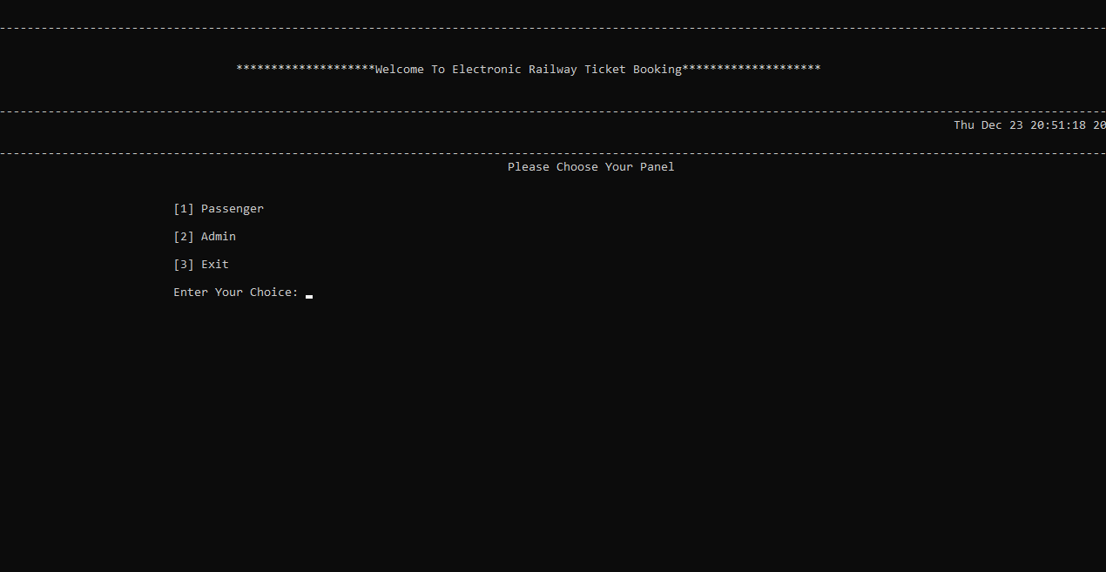
CHAPTER 6
RESULTS
Fig.6.1:Choose Your Panel
This is the Main Panel where the Passenger Panel and admin Panel is displayed. When we enter the choice as ‘1’ it displays the passenger panel and choice as ‘2’ it displays the admin panel.

Slide 39
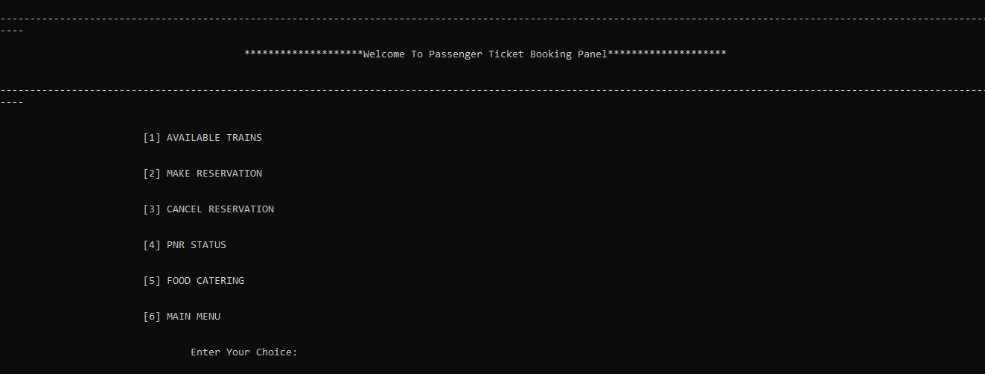
CHAPTER 6
RESULTS
Fig.6.2:Passenger Panel
This is the passenger panel where we can Make reservation , cancel them, check the availability of the trains , Preorder the food and check the pnr status as well. When we input the following options which is mentioned it leads us to the respective panels.

Slide 40
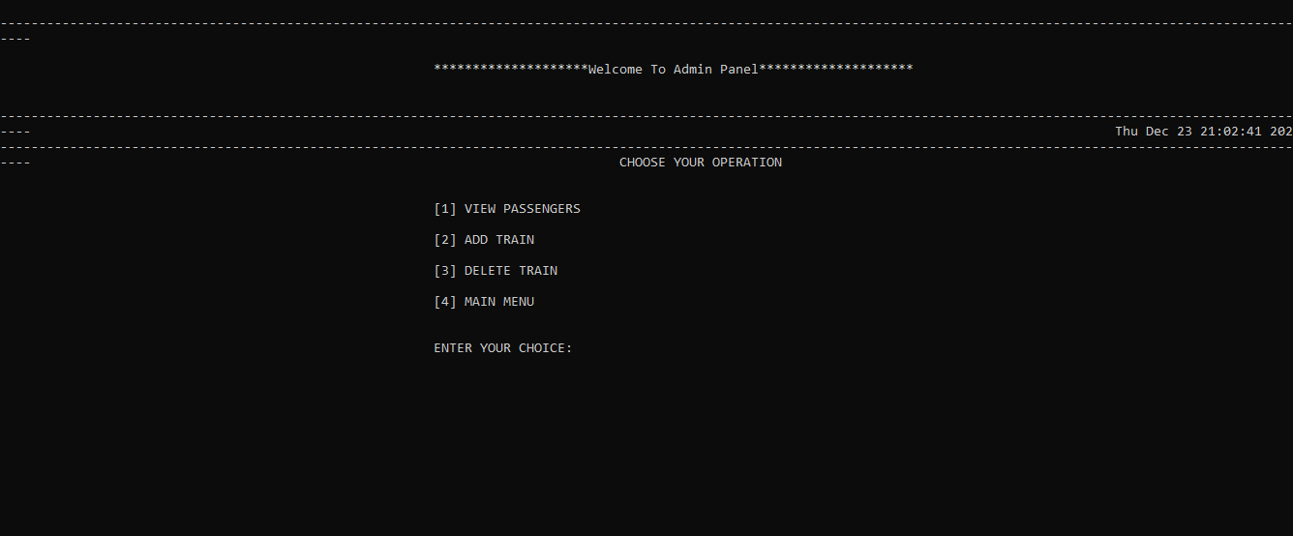
CHAPTER 6
RESULTS
Fig.6.3:Admin Panel
This is the Admin Panel where we can know details about the Passengers travelling. We can add trains and delete them as well. In order to go to the main menu if we opt for the choice ‘4’, it leads us to the main menu.

Slide 41
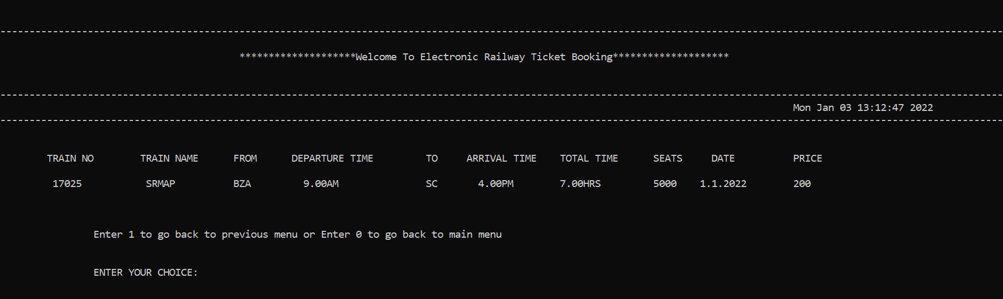
CHAPTER 6
RESULTS
Fig.6.4:Available Trains
Once we input choice‘1’ from the Passenger panel, it leads us to the available train panel. It mentions the train no: train name, date. It also includes the time and place of the departure and arrival as well.

Slide 42
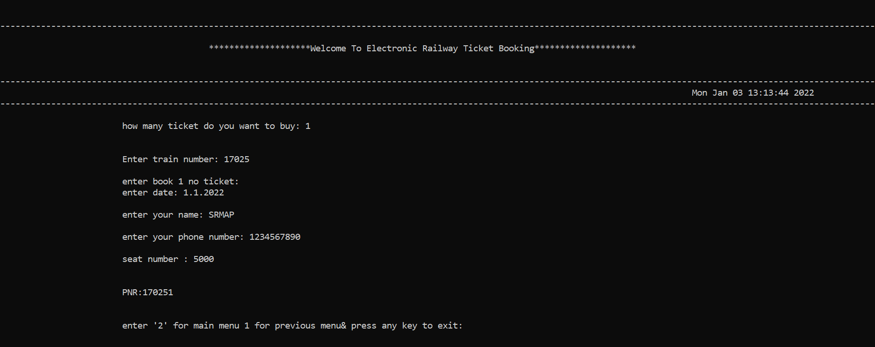
CHAPTER 6
RESULTS
Fig.6.5:Make Reservation
When we input the choice ‘2’ from the Passenger panel , it leads us to the make reservation panel where we can book the tickets. So it asks us the details of the no: of tickets which is needed and date when we need to travel and our name and contact number as well and allocate the seat accordingly.

Slide 43
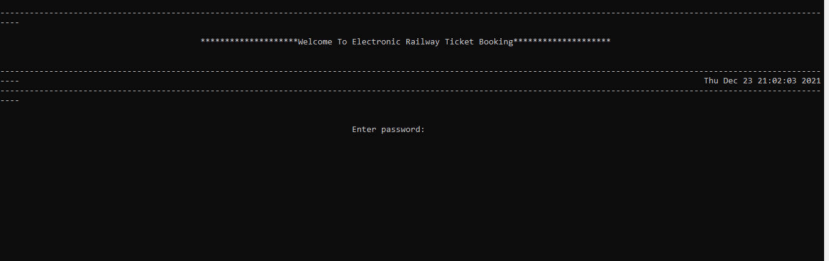
CHAPTER 6
RESULTS
Fig.6.6:Password Protected(Admin Panel)
While accessing the admin panel, a password is required to access it . So once we enter the password , it can be opened after that.

Slide 44
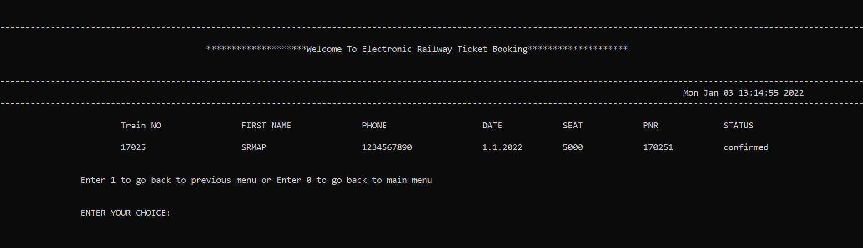
CHAPTER 6
RESULTS
Fig.6.7:View Passengers
As soon as we input choice ‘1’ from the admin panel , View passenger panel opens up. In this panel the admin can see the details of the passenger which includes their train no: , name , contact no: , date, seat number and the pnr no: as well.

Slide 45
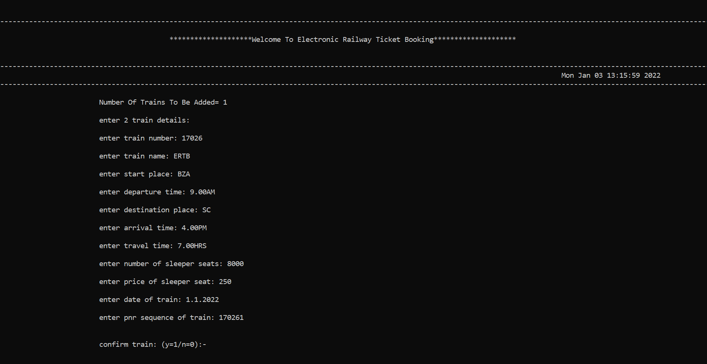
CHAPTER 6
RESULTS
Fig.6.8:Add Train
When we input choice ‘2’ from the admin panel we are redirected to the add train panel. This is the panel where the admin can add the train details mentioning the train no: , arrival and departure place , arrival and departure time, PNR Status , and no: of he seats required and the price of the seats as well.

